Slide 1
Market developments in India : Production, Consumption & Trade Issues 21ST Session of FAO – IGG Bandung, Indonesia

Slide 2
Tea Industry- Overview
Indian Tea Industry is over 150 years old.
Employs over 1.26 million workers.
50% women workers.
World production – 4907 M. kgs in 2013.
1559 million kg Green Tea.
3348 million kg Black Tea.
India’s total production 1200 million kgs – 36% of World Black Tea Production.
Exports over 200 million kgs --- Value Rs 4500 crores.
Per capita consumption in India around 733 gms. per year.
Notes:
Indian exports is a little more than 200 M. Kgs at a value of Rs.4500 crores. 10 years ago it was 183 million kgs. There is a huge domestic demand which the industry has been catering to from the increases in production. Consumption in 2005 was 760 million kgs which has gone up to in 2013 to 926 million kgs. However, our per capita consumption at 733 grams per head is low when compared to Pakistan, Turkey or U.K. where consumption ranges from 1 to 1.2 kg. This needs to be addressed.

Slide 3
INDIAN TEA – SNAP SHOT
.
2014 production likely to be marginally lower than 2013
2014 Imports following past trends
2014 Exports likely to end marginally lower
Consumption growing at 2.5% annually

Slide 4
CURRENT PRODUCTION ( Th MT)
 | January to September |  |  | January - December
 | 2014 | 2013 | (+/-) | 2013 | 2012 | +/-
North India | 681.95 | 693.82 | -11.87 | 958.62 | 886.95 | 71.67
South India | 178.29 | 171.90 | + 9.39 | 241.79 | 239.38 | 2.41
All India | 86024 | 865.75 | -5.48 | 1200.41 | 1126.33 | 74.08
Unfavourable climatic conditions has adversely impacted North India production.
Some recovery has been achieved since August 2014.
4

Slide 5
CURRENT PRICES (USD/KG)
During 2014 while North India average auction price is marginally by USD 0.04/kg, South India & All India was down by USD 0.28/kg & USD 0.06/kg respectively.
5

Slide 6
Challenges
Improving productivity (yields)
High cost of production
Adverse effects of Climate change
Quality, Value Addition & Product diversification
Marketing Issues – Domestic & Exports
Small Tea Growers – Mapping and Integration
Notes:
Read the slide.
Thrust areas are -
Increasing and Production & Productivity through Replanting and extension Planting.
Special focus on development of small holdings
Quality Assurance through Certification, value addition
Market Promotion - domestic and international
Plantation Worker’s welfare
Integrating Sustainability as the underlying value in all operations
Making R & D a part of problem solving on - climate change- Pesticide Residue issues
Regulatory measures for safeguarding the quality image of Indian teas

Slide 7
Productivity
Improving Yields by Uprooting & Replanting
Uprooting involves crop loss and long gestations
Special Purpose Tea Fund (SPTF) introduced in 2007 has accelerated annual replanting & rejuvenation rate to 1.9% (from 0.3% observed pre-SPTF period)
Notes:
Productivity and yield is a major challenge and this is being addressed by replanting of old bushes. Revenue loss due to crop loss as well as long gestation period has compounded the problem of productivity. The total area under tea at present is 5.80 lac hectares and 50 years ago it was 3.54 lac hectares. SPTF has boosted the replanting rate to 1.93 % from 0.3% in 2007.
To sustain this growth rate of uprooting and replanting activity, the Special Purpose Tea Fund (SPTF) Scheme should be further strengthened. We propose that the Subsidy rate should be revised upwards to 40% and the unit cost indexed to the annual inflation.

Slide 8
Cost Of Production
70% of COP comprises of Fixed Costs
Price realization at the farm gate level is not keeping pace with inflationary rise in the cost of inputs
High Social Welfare cost
High cost would be largely mitigated through improvement of yields.
Notes:
Fixed cost in COP is over 70%. Recommendations by the Central Government Committees on sharing of Social Welfare Costs presently borne by the industry is a constructive proposal that should be implemented with suitable modifications to relevant Schemes for Health, Sanitation, Education, specially girl’s education, Housing, Women and Child Development, Skill Training being implemented by the Panchayats so as to make them applicable for the Tea estates.
The Schemes in their present form are targeted for the BPL population and cannot be made applicable for Tea estates workers in all cases. The Government may also consider suitably amending the Plantation Labour Act (PLA) to facilitate implementation of these Schemes.

Slide 9
Climate Change
Extreme weather conditions perpetuated by high temperature, decreasing & uneven rainfall leading to floods and prolonged droughts.
Bio Diversity changes --- increased pest activity --- mosquito bugs, looper caterpillars and hardy weed species.
Expansion of present list of Plant Protection Formulations (PPF), a necessity for combating issues relating to immunity and efficacy.
Notes:
Tea areas in the North East have been witnessing extreme weather conditions leading to prolonged droughts which has adversely affected production. Pest activities in plantations have also increased escalating field maintenance operations costs. The role of irrigation for the Plantations is critical. We therefore propose the creation of irrigation infrastructure to mitigate the effects. Plantations Development Schemes therefore needs to be strengthened raising the expenditure ceiling to Rs.40 lakhs with no ceiling on irrigated area. To combat increased pest activity, there is a need for expansion of the list of PPF’s which is under consideration. We would urge that notification of the expanded list is persued by the Tea Board.

Slide 10
Quality, Value Addition , Product Diversification
Quality Up-gradation and Product Diversification - a catalyst for factory improvement, modernization, value addition and correction of product mix for sustaining exports.
Orthodox and Green Tea production is being boosted.
Notes:
The QUPDS Scheme has acted as a catalyst in modernizing our factories and also helped in product diversification particularly manufacture of Orthodox and Green Teas. We propose continuance of this Scheme with increase in subsidy component from 25% to 40%.
Orthodox subsidy : Rs 5 for leaf and Rs 2 for Dust.
Orthodox : India produces 99 Million kgs or 100 million kgs approx.
Orthodox production cost @
The Tea industry has been receiving hardly 50% to 60% of its total power requirements and has to depend on captive generation for production. Since generators also require up-gradation, we propose that generators installed in factories be included under the purview of the Quality Up-gradation Scheme

Slide 11
Marketing : Domestic
Domestic consumption is lagging at 733 gms per capita – lower than many countries like UK, Ireland, Pakistan, etc
Domestic promotion is needed :
to attract the Youth & young professionals with high disposable income and aspirational life style
Industry & Tea Board jointly conducting promotion programme – B2C
Notes:
The Tea industry has initiated B2C campaign in partnership with the Tea Board to boost domestic consumption. This initiative needs to be sustained with higher outlays so that the per capita consumption of tea in India can be increased from its present level of around 733 gms per head per year. B2C campaign were held recently in Gurgaon and Ahmedabad which had the urban youth in large numbers. Our plan is to take the road show to 100 cities in phases and for this Tea Board’s continued support is essential.
E-Auctions have led to improvement in the price discovery. The system needs to evolve to a paperless transaction paradigm. We would request the Tea Board’s financial support in this regard.

Slide 12
Indian Tea Carnival - Chai Ho Jaye
.
Mr. Siddharth, Chairman Tea Board at the inauguration
India's first ever Tea Carnival – Chai Ho Jaye – was organised in collaboration with Tea Board of India in Gurgaon and Ahmedabad.
More cities planned to be covered.

Slide 13
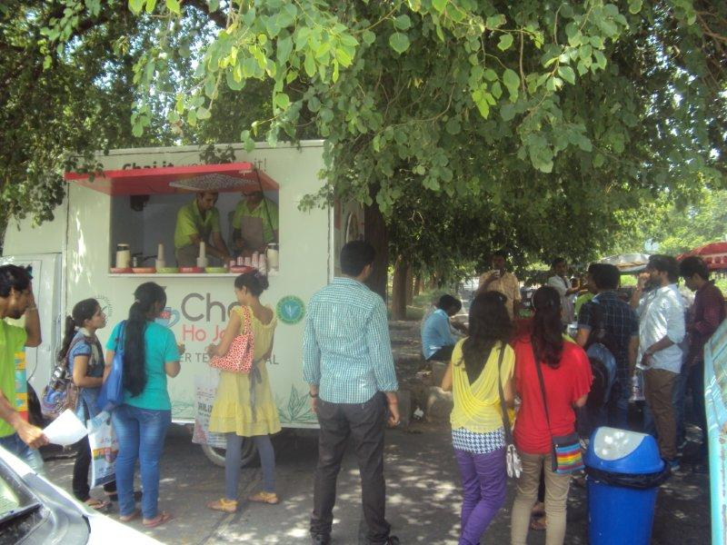
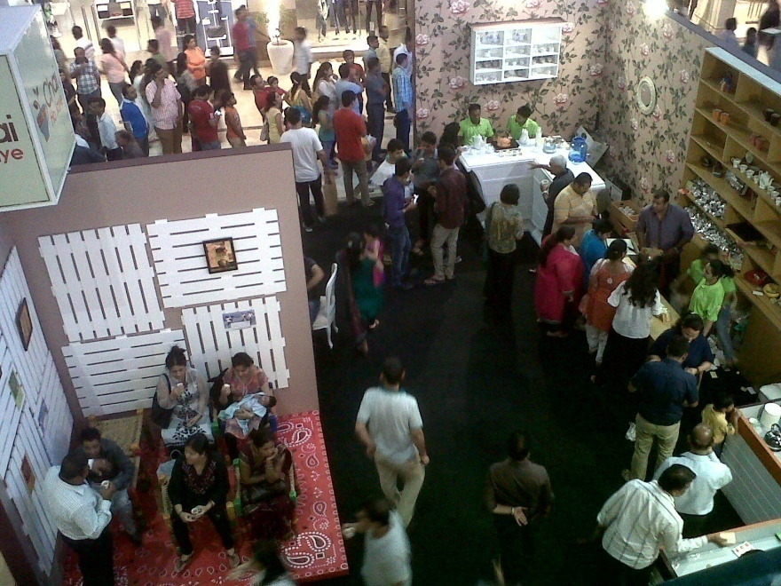
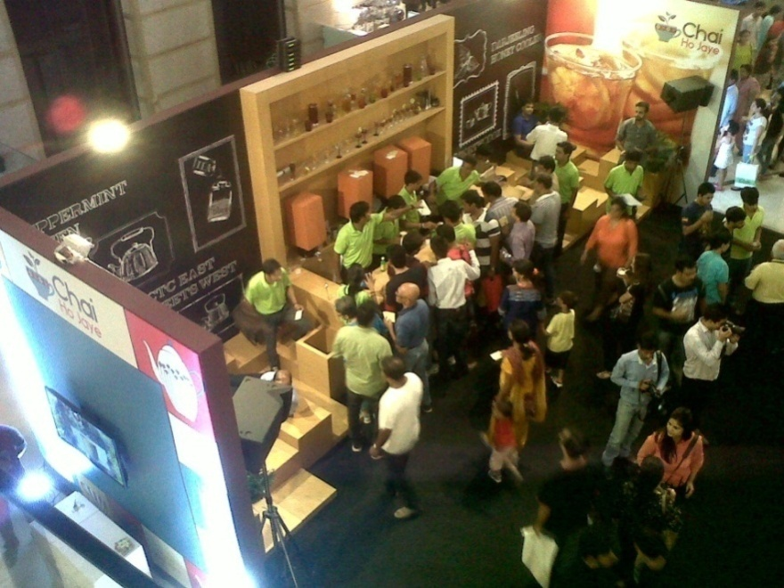
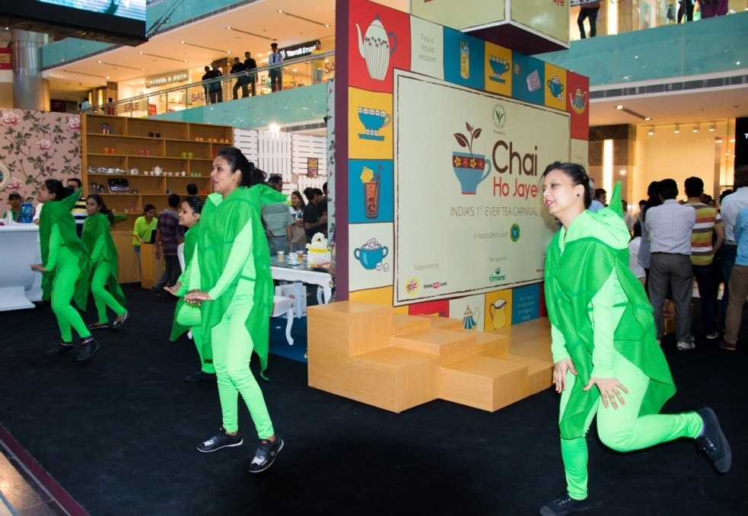
Indian Tea Carnival - Chai Ho Jaye

Slide 14
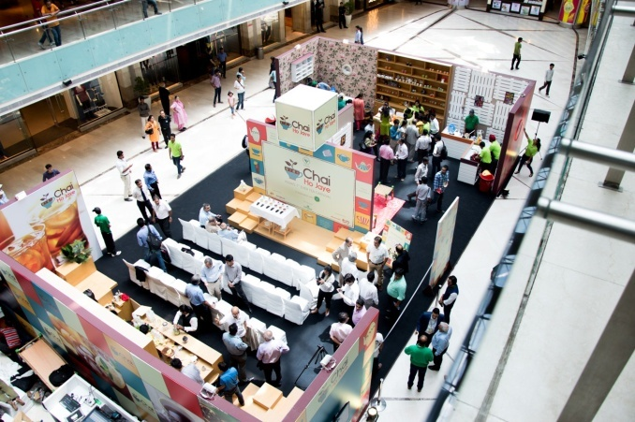
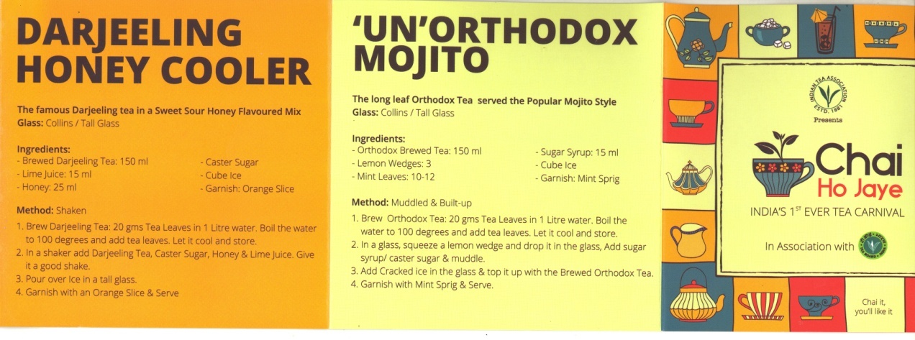
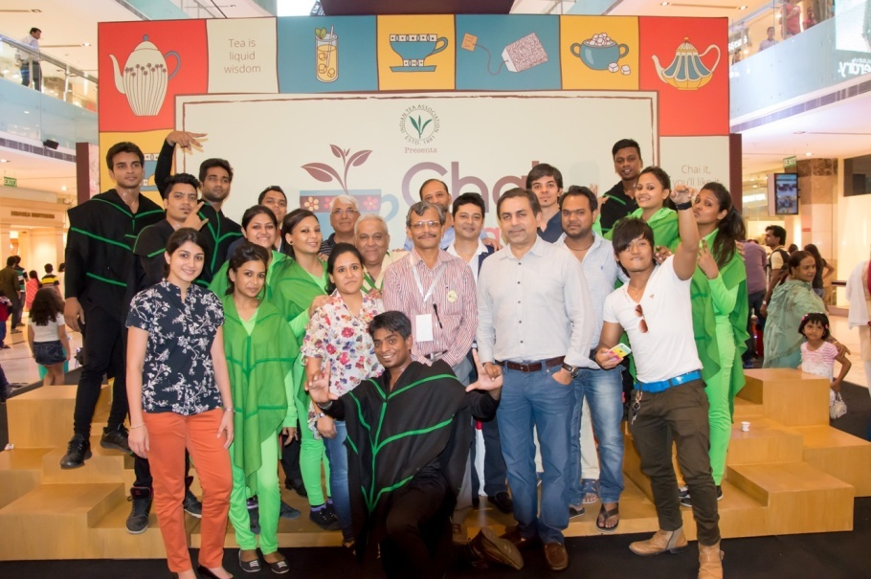
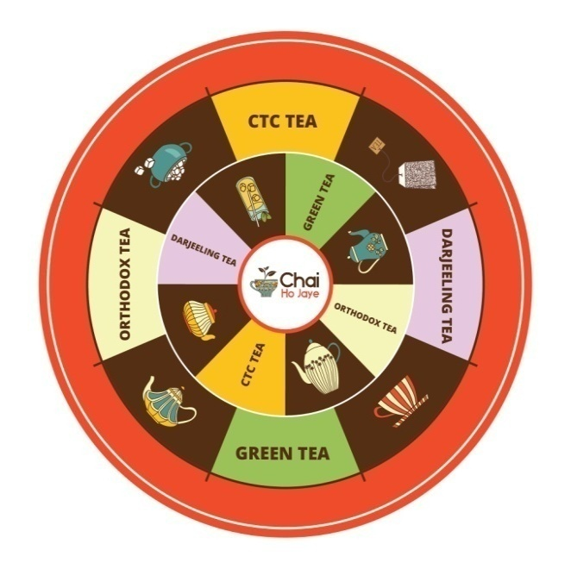
Indian Tea Carnival - Chai Ho Jaye

Slide 15
Marketing : Exports
Industry in association with Tea Board mounted delegations to several focused markets in 2014 and planning to do so I future.
India’s strength in Origins teas - with unique characteristics -
Assam, Darjeeling, Nilgiri, Dooars, Terai, Cachar, other South India origins
Goal is to boost both volume & value
Quality, Food Safety & Sustainable production critical

Slide 16
Sustainability Issues
Rainwater Harvesting
Recharging Groundwater
Effluent & Waste Management
Afforestation & Micro climate management
Adoption of Renewable Energy Sources
Safe Use of Pesticides & Adoption of Sustainable Field Practices –
Trustea Code
Plant Protection Code (Version-2 in Tea Board website)

Slide 17
PLANT PROTECTION CODE
The Tea Board of India has launched a 'Plant Protection Code' (PPC).
The code is a best practice guide to sustainable and safe tea production and sustainability.
PPC covers :
Use of Palnt Protection Formulations (PPFs) cleared for use in Tea by Central Insecticide Board, GoI
Adherence to MRLs for pesticides laid down by the FSSAI

Slide 18
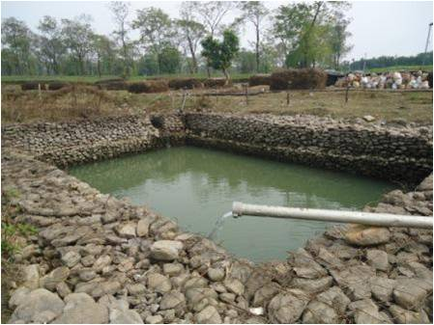
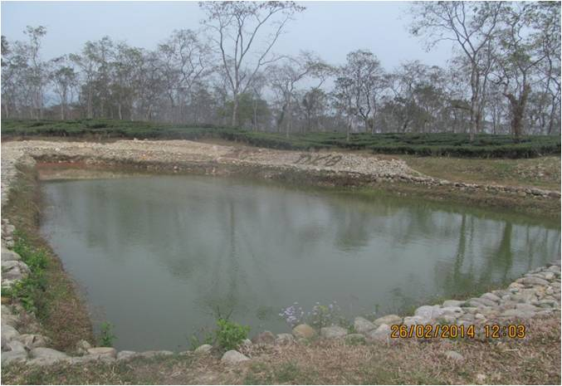
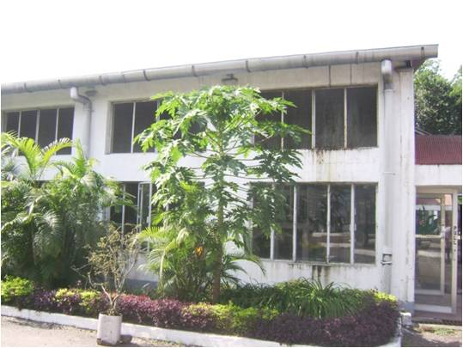
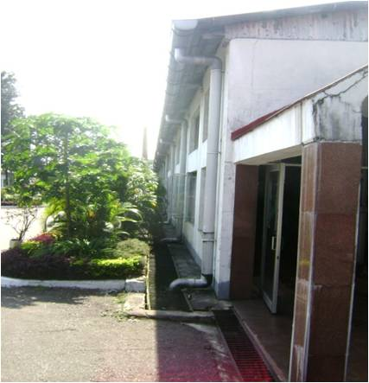
SUSTAINABILITY - Initiatives
Ground water recharging
RAIN WATE COLLECTION
11/3/2014
18

Slide 19
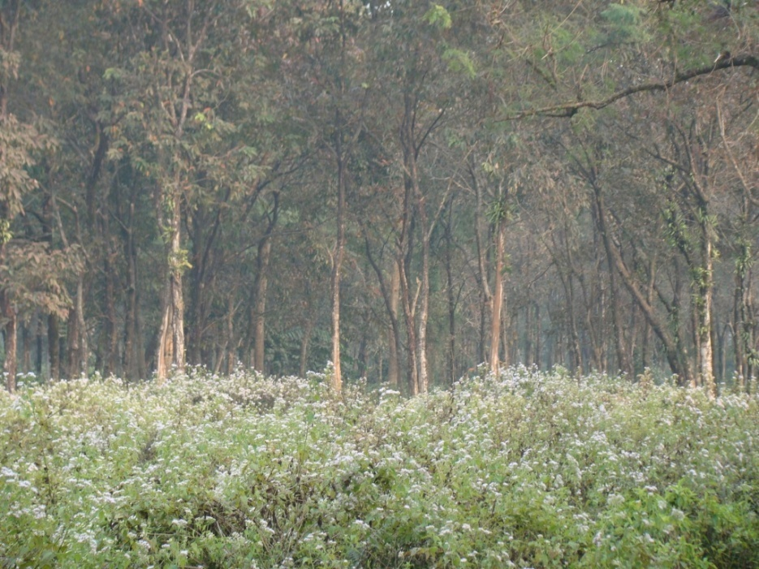
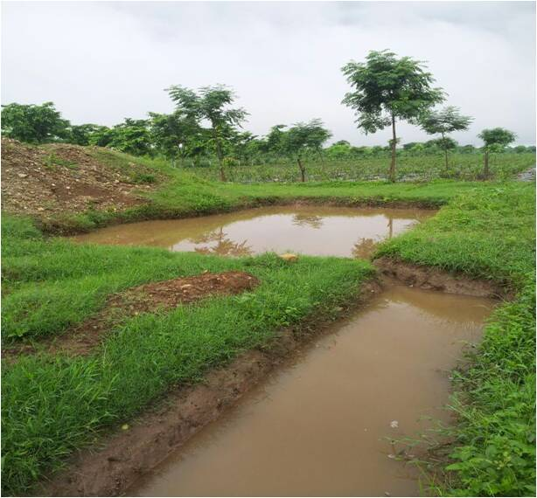
Afforestation
Rain water harvesting reservoir.jpg

Slide 20
Small Grower
Small Tea Growers (STG) account for 33% of all India production. Their growth and contribution has boosted the local economy significantly in the last two decades.
Challenge of integrating STG produce with Organized Estate Factories / BLF keeping in view the quality & food safety compliances.
Tea Board of India Small Growers Directorate is playing a developmental role in providing an opportunity to Small growers to move up the value chain.
Notes:
Small Tea Growers produce over 33 per cent of teas and are vital to the industry. Their contribution is phenomenal. Had they not been there our crops would have been much lower. The Tea Board Directorate is playing a developmental role in integrating this segment and the organized sector is keen to assist the Tea Board on this initiative.

Slide 21
Production : Corporate & BLF Sector (MKg)
 |  |  | 2005 | 2013 | +/- | CAGR
1 | Total Crop |  | 946 | 1200 | 254 | 3.02%
2 | BLF/Cooperative |  | 236 | 375 | 139 | 5.9%
3 | Estate Factory Sector(1-2) |  | 710 | 825 | 115 | 1.9%
4 | % of BLF in crop |  | 25% | 31%
As per estimates organized sector crop has Increased only by 1.9% whereas BLF sector has registered 5.9% increase
Notes:
Slide no.11 - Production : Corporate & BLF Sector (M Kg)
To illustrate the position this slide shows up the fact of a de-growth of 52 million kgs. of the corporate sector presenting India the first of its sustainability challenges. Without the small grower performance India could have been in trouble with increasing consumption.

Slide 22
THANK YOU

